Slide 1
Software Engineering
Chapter 3
Software Project Management
– Estimation, Scheduling and Metrics
Learning Outcomes
Be able to choose a cost estimation technique for a software project
Be able to estimate the size of a software project based on its requirements specification
Be able to establish a schedule for a software project and represent this as a Network Analysis and Gantt chart
Know how to apply a range of software metrics
Understand the role of configuration management

Slide 2
Components of Project Management
A nice simple view...
Project
Work Product
Schedule
Task
Participant

Slide 3
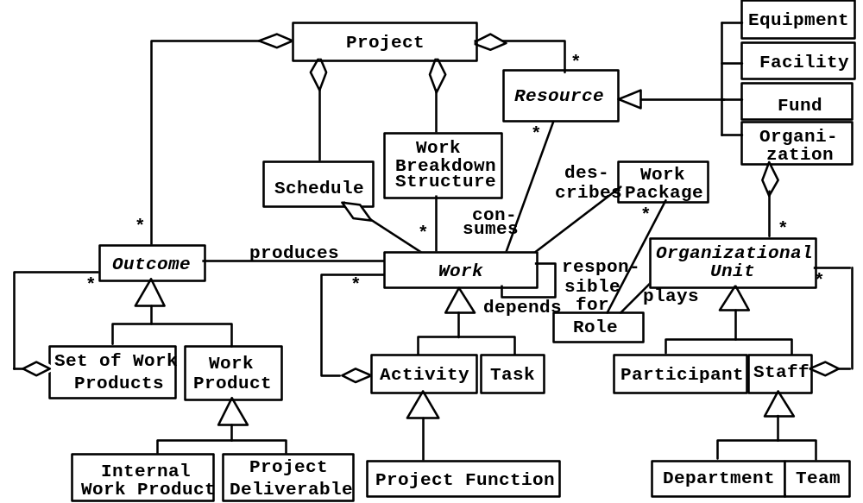
Or a rather more complex view...
For your interest only!

Slide 4
Cost Estimation Techniques
Expert Judgement
Past Experience
  Build up a databank of past projects and their cost
Top down
  Break the problem up into smaller problems and estimate these
Function Point Analysis
  Uses the requirements specification to assess inputs, outputs, file accesses, user interactions and interfaces and calculates the size based on these
Algorithmic Cost Modelling
  COnstructive COst MOdelling (COCOMO), Barry Boehm 1981, has been an influential approach

Slide 5
Function Point Analysis (FPA)
The following system components are considered
  Number of external inputs (e.g. input files of transactions) (I)
  Number of external outputs (e.g. output files of reports, messages) (O)
  Number of user interactions / enquiries (e.g. menu selection, queries...) (E)
  Number of internal or logical files used by the system (L)
  Number of external or interface files shared with other applications (IF)
In each case, depending on the number of field types associated with each component, and the variety of file types that these elements refer to, these components are rated as simple, average or complex

Slide 6
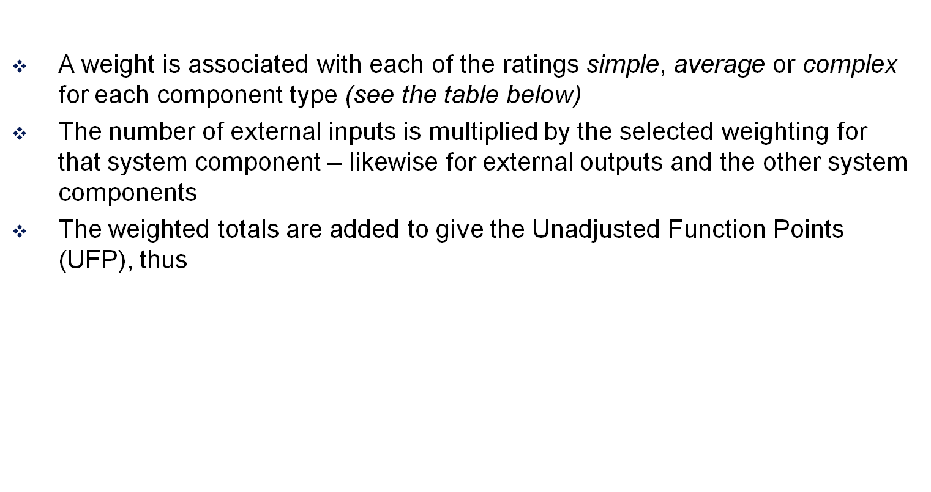
Function Point Analysis (FPA) contd
UFP = Σ Input(w_{i} ) + Σ Output(w_{o} ) + Σ Enquiry(w_{e} )
+ Σ Logical File(w_{l} ) + Σ Interface File( w_{if} )
COMPONENT | COMPLEXITY LEVEL
 | simple | average | complex
Input (I) | ×3 | ×4 | ×6
Output (O) | ×4 | ×5 | ×7
Enquiry (E) | ×3 | ×4 | ×6
Internal (Logical) File (L) | ×7 | ×10 | ×15
Interface File (IF) | ×5 | ×7 | ×10

Slide 7
Function Point Analysis (FPA) contd
UFP is then adjusted to take account of the type of application
  This adjustment is made by multiplying UFP
  by a Technical Complexity Factor, TCF
  As preparation for calculating TCF, 14 General System Characteristics (GSCs) are scored for Degree of Influence from 0 (no influence) to 5 (strong influence):
    data communications, distributed functions, performance, heavily used configuration, transaction rate, on-line data entry, end-user efficiency, on-line update, complex processing, reusability, installation ease, operational ease, multiple sites, facilitate change
  TCF is then calculated as follows:
  TCF = 0.65 + 0.01×DI where
    DI = the total Degree of Influence from the 14 scored characteristics

Slide 8
Function Point Analysis (FPA) contd
A comment on the TCF calculation, also known as the Value Adjustment Formula or VAF:
  The top score from the General System Characteristics is 14 × 5 = 70
  A normal or moderate score (where collectively the GSCs are midway between ‘no influence’ and ‘strong influence’) would be 14 × 2.5 = 35
  We need to make this case, where the GSCs total 35, the case where the Technical Complexity Factor = 1, and therefore has no effect as a multiplier on the Unadjusted Function Points (UFP)
  One way to achieve this is to multiply 35 by 0.01 and then add 0.65
  That is the basis of the VAF!
  Consider an application whose GSCs total 45
    45 × 0.01 + 0.65 = 1.1
    Such an application is 0.1 more complex than normal and its Technical Complexity Factor of 1.1 reflects this.

Slide 9
FPA: Function points in practice
So, function points (FP) are calculated as FP = UFP * TCF
FPs can be used to estimate Lines of Code (LOC), assuming, of course, that we can approximate the average number of LOC per FP for a given language – e.g. 1 FP =
  106 lines of COBOL
  128 lines of C
  64 lines of C++
  32 lines of VB

Slide 10
FPA: Function points in practice
But there are some difficulties:
  FPs – and particularly the scores given to the General System Characteristics – are very subjective: they cannot be counted automatically and depend on the analyst’s assessment
  There are only 3 complexity levels for weighting the functionality of the main system components
  The approach has to be calibrated or adjusted for different programming tasks and environments
  Ultimately experience will tell how well the approach is working: does 1 FP really match 32 lines of VB?

Slide 11
COCOMO: algorithmic cost modelling
Cost is estimated as a mathematical function of product, project and process attributes
The function is derived from a study of historical costing data
The most commonly used product attribute for cost estimation is LOC (lines of code or code size)
One widely used costing model is COCOMO
– Constructive Cost Model
COCOMO exists in three forms
  Basic - gives a rough estimate based on product attributes
  Intermediate - modifies the basic estimate using project and process attributes
  Advanced - estimates project phases and parts separately

Slide 12
COCOMO
The class of project affects the multipliers
and exponents used in basic COCOMO
3 classes of project are recognised
  Simple (or Organic): small teams, familiar environment, well-understood applications, no difficult non-functional requirements
  Moderate (or Semi-detached): project team may have experience mixture, system may have more significant non-functional constraints, organisation may have less familiarity with application
  Embedded: hardware/software systems, tight constraints, unusual for team to have deep application experience
Formulae for basic COCOMO : E = a × KDSI^{b}; D = 2.5 × E^{c}
  E = Effort in Person-months
  a ,b & c are constants based on project class & historical data
  D = development time in months*
  KDSI = Thousands of Delivered Source Instructions (~Lines of Code)
  *same formula for D used with Intermediate COCOMO

Slide 13
COCOMO
Remember, the multipliers and exponents for basic COCOMO’s formulae change according to the class of project:
Variables
Project Class a b c
Organic 2.4 1.05 0.38
Semi-detached 3.0 1.12 0.35
Embedded 3.6 1.20 0.32
Example:
Organic mode: 42,000 delivered source instructions
E = 2.4 × 42 ^{1.05}
= 121.5 person months
D = 2.5 × 121.5 ^{0.38}
= 15.5 months
No. Personnel = E/D = 7.8
Formulae for basic COCOMO : E = a × KDSI^{b}; D = 2.5 × E^{c}
  E = Effort in Person-months
  Values for a ,b & c are based on project class & historical data
  D = development time in months
  KDSI = Thousands of Delivered Source Instructions
  (~Lines of Code)

Slide 14
Intermediate COCOMO
Intermediate COCOMO takes the Basic COCOMO formula a × KDSI^{b}
as its starting point
  In intermediate COCOMO the value a is equal to 3.2, 3.0 and 2.8, for organic, semi-detached and embedded projects respectively.
Additionally Intermediate COCOMO identifies personnel, product, computer and project attributes which affect cost
With intermediate COCOMO, the basic cost is adjusted by attribute multipliers: presently we’ll give values to a sample of these multipliers:
1. Product attributes
• Required software reliability (RELY)
• Database Size (DATA)
• Product Complexity (CPLX)
2. Computer Attributes
• Execution time constraints (TIME)
• Storage constraints (STOR)
• Virtual machine volatility (VIRT)
• Computer turnaround time (TURN)

Slide 15
Intermediate COCOMO
3. Personnel Attributes
• Analyst capability (ACAP)
• Programmer capability (PCAP)
• Applications experience (AEXP)
• Virtual machine experience (VEXP)
• Programming language experience (LEXP)
4. Project Attributes
• Modern programming practices (MODP)
• Software tools (TOOL)
• Required development schedule (SCED)
These are attributes which were found to be significant in one organisation with a limited project history database
Other attributes may be more significant for other projects and other organisations

Slide 16
Example: Embedded Software
Scenario: development of embedded software system on microcomputer hardware.
Assume that Intermediate COCOMO formula a × KDSI^{b} predicts a 45 person-month effort.
The following attributes (with the multiplier values shown) are relevant to the organisation
RELY (1.15), STOR (1.21), TIME (1.10), TOOL (1.10), VEXP(1)
Intermediate COCOMO therefore predicts
  45 × 1.15 × 1.21 × 1.1 × 1.1 × 1 = 75.77 person months
At £3,000 per person-month this means a total cost of £227,310
Alternative 1: Use a faster CPU and more memory to reduce TIME and STOR attribute multipliers (though there will be less software support)
Alternative 2: Buy some software tools (CASE tools) to reduce the TIME and TOOL multipliers (though more virtual machine experience will be needed)

Slide 17
Alternative 1: Faster Machine
Say processor capacity and storage are increased
(corresponding multipliers decrease)
  TIME and STOR multipliers = 1
  RELY still 1.15
Say fewer tools are available (corresponding multiplier increased)
  TOOL = 1.24
Extra investment of £30,000 required for the faster machine
Staff cost = 45 × 1.24 × 1.15 = 64.17 Person-months = £192,510
Total cost = £192,510 + £30,000 = £222,510
Cost saving = £227,310 – £222,510 = £4,800

Slide 18
Alternative 2: Better tools
Extra investment of £15,000 required for the software tools
Reduces TIME multiplier (down to 1)
and TOOL multiplier (down to 1)
Increases VEXP multiplier to 1.1
RELY still 1.15, STOR still 1.21
Staff Cost = 45 × 1.15 × 1.21 × 1.1 = 68.88 person-months = £206,640
Total Cost = £15,000 + £206,640 = £221,640
Cost Saving = £227,310 - £221,640 = £5,670
ALTERNATIVE 2 is best

Slide 19
Work Breakdown Structure
The hierarchical representation of all the tasks in a project is called the work breakdown structure (WBS)
First Version of a UML Model…
But Tasks are Parts of Activities – so are there more granular representations of the project that make clear the relationships between activities and tasks?

Slide 20
Creating Work Breakdown Structures
Two major philosophies
  Activity-oriented decomposition (“Functional decomposition“)
    Write the book
    Get it reviewed
    Do the suggested changes
    Get it published
  Result-oriented (“Object-oriented decomposition“)
    Chapter 1
    Chapter 2
    Chapter 3

Slide 21
Project Scheduling
Work Breakdown Structures
  Divide the project up into tasks
OnLine Frequent Flyer Points
Obtain Funding
Client Side Code
Implement Database
Screen Designs
Validation
Linking to Server Side
Main Applet
Authorisation Code
Account Balance
System Testing
Calculate Account Balance
Display Account Balance
Release

Slide 22
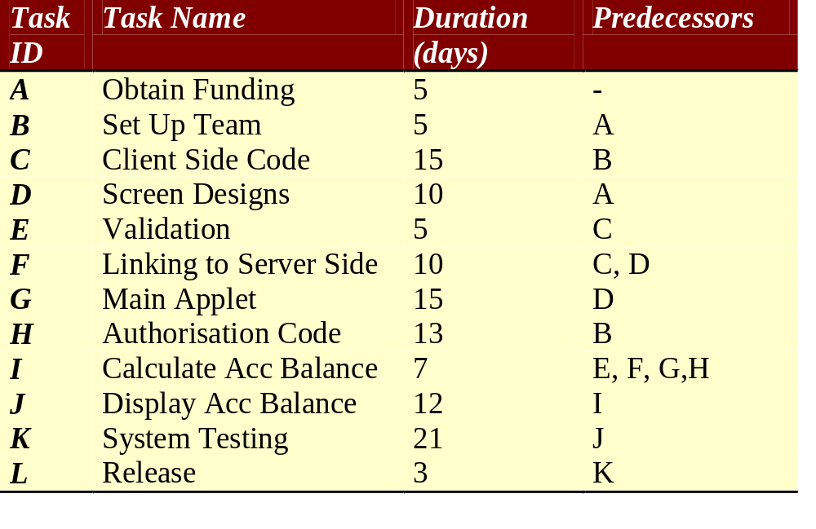
Confirm tasks and their predecessors

Slide 23
Network Analysis - durations
ES
D
EF
13
H
5
Start
3
5
E
LS
F
LF
L
B
ES = Earliest Start
D = Duration
EF = Earliest Finish
LS = Latest Start
F = Float
LF = Latest Finish
15
10
C
F
21
0
0
0
5
K
Start
A
15
0
0
0
G
10
7
12
Include the information we have...
D
I
J

Slide 24
Network Analysis – ES & EF
ES
D
EF
10
13
23
5
H
Start
3
5
5
10
E
LS
F
LF
L
B
10
15
25
10
C
F
21
0
0
0
0
5
5
K
Start
A
15
0
0
0
G
EF=ES+D
ES is the latest EF of a task’s predecessors
5
10
15
7
12
D
I
J
Work from left to right...

Slide 25
Network Analysis – ES & EF
ES
D
EF
10
13
23
H
25
5
30
Start
75
3
78
5
5
10
E
LS
F
LF
L
B
10
15
25
25
10
35
C
F
54
21
75
0
0
0
0
5
5
K
Start
A
15
15
30
0
0
0
G
EF=ES+D
ES is the latest EF of a task’s predecessors
5
10
15
35
7
42
42
12
54
D
I
J
Work from left to right...

Slide 26
Network Analysis – LS & LF
ES
D
EF
10
13
23
H
25
5
30
Start
75
3
78
5
5
10
22
35
E
LS
F
LF
L
B
30
35
75
78
5
10
10
15
25
25
10
35
C
F
54
21
75
0
0
0
10
25
25
35
K
0
5
5
15
15
30
54
75
Start
A
0
0
0
0
5
G
20
35
Work back from right to left... Assume we want to finish as soon as possible...
5
10
15
LF of preceding task = earliest LS of following tasks.
LS = LF – D.
35
7
42
42
12
54
D
I
J
10
20
35
42
42
54

Slide 27
Network Analysis –Float & Critical Path
ES
D
EF
10
13
23
H
25
5
30
Start
75
3
78
5
5
10
22
12
35
E
LS
F
LF
L
B
30
5
35
75
0
78
5
0
10
10
15
25
25
10
35
C
F
54
21
75
0
0
0
0
5
5
10
0
25
25
0
35
K
Start
A
15
15
30
54
0
75
0
0
0
0
0
5
G
F = LF – EF.
Critical Path = the path (to finish the project) along which all tasks are critical: i.e. there is no spare time on the CP (float F = 0 throughout).
20
5
35
5
10
15
35
7
42
42
12
54
D
I
J
10
5
20
35
0
42
42
0
54

Slide 28
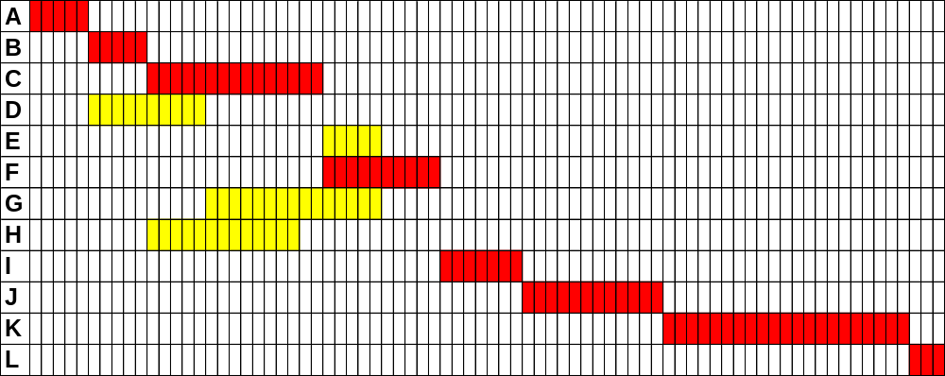
Gantt Chart
Task
Days

Slide 29
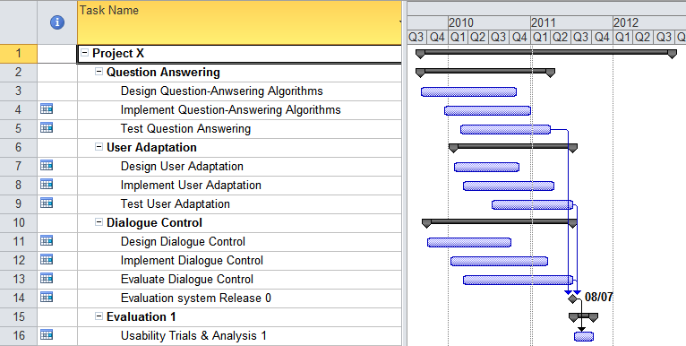
Gantt Chart contd

Slide 30
Configuration Management (CM)
In an on-going project, all products of the software process
have to be managed
  Specifications
  Designs
  Programs
  Test data
  User manuals
Thousands of separate documents are generated
for a large software system
CM Plan
  Defines the types of documents to be managed and a document naming scheme
  Defines who takes responsibility for the CM procedures and creation of baselines
  Defines policies for change control and version management
  Defines the CM records which must be maintained

Slide 31
The configuration database
All CM information should be maintained in a configuration database
This should allow queries
  Who has a particular system version?
  What platform is required for a particular version?
  What versions are affected by a change to component X?
  How many reported faults in version T?
The CM database should preferably be linked to the software being managed
  When a programmer downloads a program it is
  ‘booked’ out to him/her
  Could be linked to a software development tool

Slide 32
The change management process
Request change by completing a change request form
Analyze change request
if
change is valid
then
Assess how change might be implemented
Assess change cost
Submit request to change control board
if
change is accepted
then
repeat
make changes to software
submit changed software for quality approval
until
software quality is adequate
create new system version
else
reject change request
else
reject change request

Slide 33
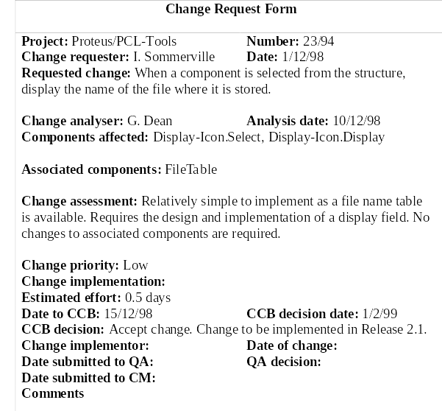
Change request form

Slide 34
Derivation history
Record of changes applied to a document or
code component
Should record, in outline, the change made, the rationale for the change, who made the change and when it was implemented
May be included as a comment in code: if a standard prologue style is used for the derivation history, tools can process this automatically
/***********************************************************
/* ID Modified By Date Reason
/* TC01 S Smith 1 Dec 02 Update to Tax
/* Rules
/* TC02 J Bloggs 10 Dec 02 Fix x bug in
/* price calc

Slide 35
Versions/variants/releases
Version An instance of a system which is functionally distinct in some way from other system instances
Variant An instance of a system which is functionally identical but non-functionally distinct from other instances of a system
Release An instance of a system which is distributed to users outside of the development team
Version Numbering
  Simple naming scheme uses a linear derivation
  e.g. V1, V1.1, V1.2, V2.1, V2.2, etc.
  Better way is Attribute Naming
    Examples of attributes are Date, Creator, Programming Language, Customer, Status etc
    e.g. MySys (language =Java, platform = Win 7, date = Jan 2011)

Slide 36
Software Metrics
“When you can measure what you are speaking about and express it in numbers, you know something about it” (Kelvin)
Allow processes and products to be assessed
Used as indicators for improvement
Size-oriented Metrics
  Lines of Code (LOC)
  Effort (Person-Months)
  Cost (£)
  Pages of Documentation
  Numbers of Errors
  Errors per kLOC
  Cost per kLOC
  Errors per person-month

Slide 37
Quality Metrics
Defect Removal Efficiency
  DRE = E/(E+D)
    E = No. Errors, before delivery
    D = No. Defects after delivery
    Measures how good you are at quality assurance
    DRE should be 1
    (i.e. All errors detected and resolved,
    and no defects reported after delivery)
Defects per kLOC
  C = No. Defects/ kLOC
    Defect = lack of conformance to a requirement
    Measures correctness

Slide 38
Quality Metrics
Integrity
  A system’s ability to withstand attacks
  (incl. Accidental ones) on its security
  I = Σ [1 - threat × (1 - security)]
  threat = probability that an attack
  of a particular type will occur at a given time
  security = probability that an attack
  of that type will be repelled – e.g.
  Sum of
  [1 - threat × (1 - security)]
    [1 – 0.10 × (1 - 0.99)] = 0.999 +
    [1 – 0.50 × (1 – 0.85)] = 0.925 +
    [1 – 0.75 × (1 – 0.90)] = 0.925
Level of integrity for 3 threat types is 2.849

Slide 39
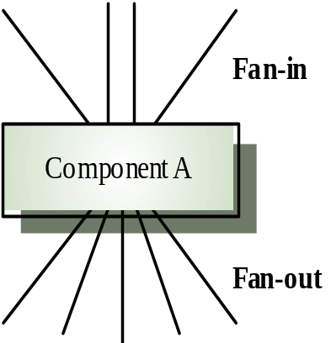

Quality Metrics
Design Complexity
  'fan-in and fan-out' in a structure chart.
  High fan-in (number of calling functions) = high coupling
  High fan-out (number of calls) = high coupling (complexity).
  Length is any measure of program size such as LOC
  Complexity = Length * (Fan-in * Fan-out)²
  (Henry & Kafura, 1990)
Other metrics include
  Cyclomatic complexity: the complexity of program control
  Length of identifiers
  Depth of conditional nesting
  For supporting documentation: the Gunning Fog Index based on length of sentences and no. of syllables
  (complex words have 3+ syllables):

Slide 40
Reliability Metrics
Probability of failure on demand
  This is a measure of the likelihood that the system will fail when a service request is made
  POFOD = 0.001 means 1 out of 1000 service requests result in failure
  Relevant for safety-critical or non-stop systems
  Computed by measuring the number of system failures for a given number of system inputs
Rate of occurrence of failures at Time t (ROCOF)
  The mean rate of failures per unit time at time t
  ROCOF of 0.02 means 2 failures are likely in each 100 operational time units
  Relevant for operating systems, transaction processing systems
  If ROCOF is increasing the system is deterioring;
  if ROCOF is decreasing, the system is improving

Slide 41
Reliability Metrics
Mean time to failure
  Measure of the time between observed failures
  MTTF of 500 means that the time between failures is on average 500 time units
  Computed by measuring the time (or number of transactions) between system failures
Mean time to Repair (MTTR)
  Average time to correct a failure
  Computed by measuring the time from the failure occurs to the time it is repaired
Availability
  Measure of how likely the system is available for use. Takes
  repair/restart time into account
  AVAIL = MTTF / (MTTF + MTTR)

Slide 42
Software Engineering
Chapter 3
Software Project Management
– Estimation, Scheduling and Metrics
Learning Outcomes
Be able to choose a cost estimation technique for a software project
Be able to estimate the size of a software project based on its requirements specification
Be able to establish a schedule for a software project and represent this as a Network Analysis and Gantt chart
Know how to apply a range of software metrics
Understand the role of configuration management

